Slide 1
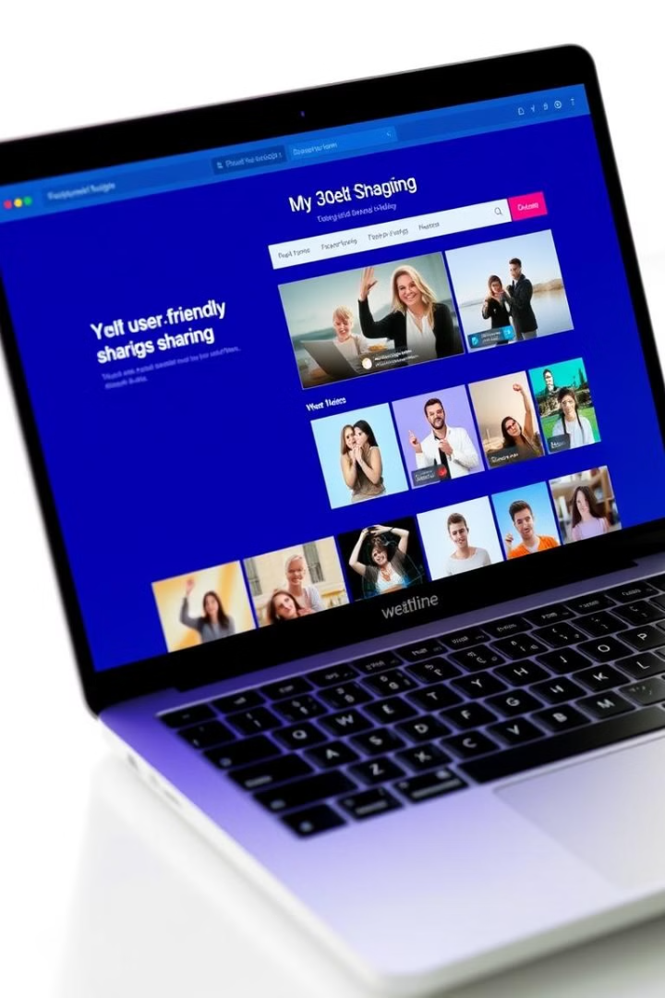
Cloud-Native Media Sharing Platform
Scalable Web App using Azure, Django REST Framework, and Frontend Technologies
Create By:

Slide 2

Problem Statement & Justification
1
Problem
2
Challenges
Need reliable platform to upload, store, and share media.
Handling large files, low latency, scalability, security.
3
Why Cloud?
Scalability, availability, cost-effectiveness.

Slide 3

Solution Overview
Objective
Design media-sharing web app for uploading, viewing, managing media.
Frontend
HTML, CSS, JavaScript, AJAX.
Backend
Django & Django REST Framework.
Cloud Services
Azure Blob Storage, PostgeSQl, App Services.

Slide 4





System Architecture
Frontend
User Interface
REST API
Django Backend
PostgreSQL DB
Database Storage
Blob Storage
Media Files

Slide 5
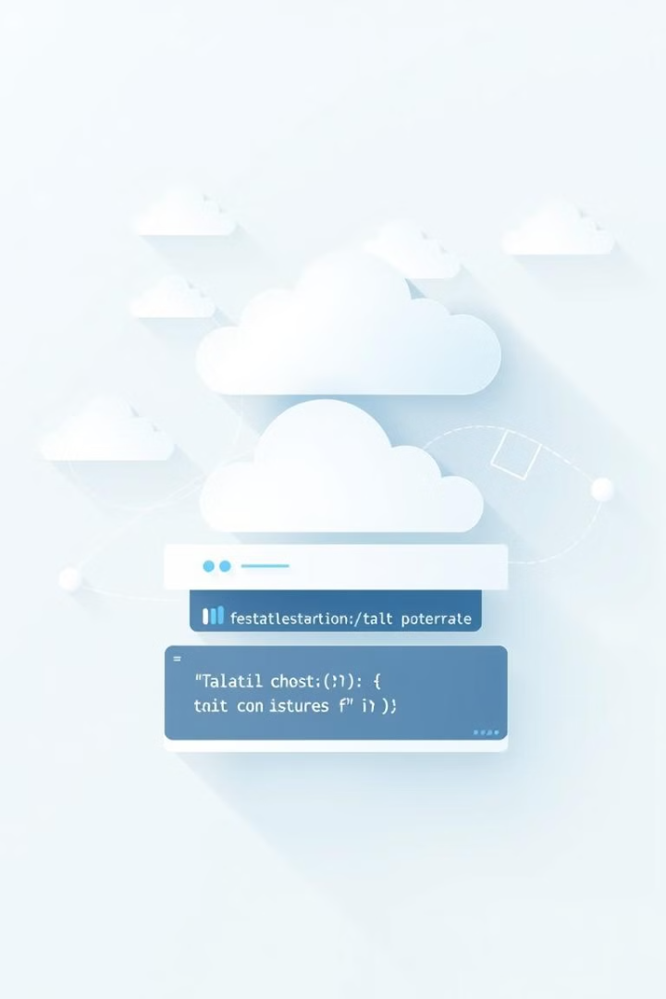
Technology Stack
Component
Technology Used
Frontend
HTML, CSS, JavaScript, AJAX
Backend
Django, Django REST Framework
Database
PostgreSQL
Storage
Azure Blob Storage
Hosting
Azure App Services
APIs
RESTful APIs
Security
Azure Authentication, JWT Tokens

Slide 6

Why Above Tech Stack?
The chosen technology stack ensures a scalable, efficient, and
user-friendly media-sharing platform. HTML, CSS, and JavaScript with
AJAX provide a responsive and dynamic frontend, enabling seamless media
uploads and real-time interactions. Django and Django REST Framework (DRF)
handle the backend, offering a robust API for managing media assets with built-in
security and scalability. A SQL database ensures structured storage for metadata
with optimized query performance. Azure Blob Storage efficiently manages large
media files, while Azure App Services hosts the backend, providing auto-scaling
and security. JWT authentication secures API endpoints, and Azure CI/CD
pipelines streamline deployments for continuous integration and updates,
ensuring a smooth and maintainable development workflow.

Slide 7
Database Design & Schema
SQL Database
Schema Design
Scalability
Structured data storage.
Ensures data integrity with relationships.
Can handle large datasets efficiently.

Slide 8

API Design (CRUD Operations)
Upload Media
1
POST /api/upload/
2
Retrieve Media
GET /api/media/<id>/
Delete Media
3
DELETE /api/media/<id>/
4
List Media
GET /api/media/

Slide 9



Cloud Deployment Strategy
Blob Storage
App Services
PostgreSQL
Scalable media storage.
Hosting Django API.
SQL database.

Slide 10
Why This Strategy?
The chosen cloud deployment strategy ensures scalability, reliability, and cost efficiency by leveraging Azure's cloud-native services. Azure App Services hosts the Django backend with built-in auto-scaling and security, while Azure Blob Storage efficiently manages large media files with global CDN integration for faster access. A SQL database stores metadata, ensuring structured data integrity and optimized queries. Azure API Management secures and optimizes REST API calls, while a CI/CD pipeline automates deployments, reducing manual errors and ensuring smooth updates. Finally, Azure Monitoring & Application Insights provide real-time performance tracking and security monitoring, making the system robust and efficient.

Slide 11



Scalability Considerations
2
Database Optimization
1
Horizontal Scaling
Storage Optimization
3

Slide 12
References
Christie, T. (2011). Home - Django REST framework. [online] Django-rest-framework.org. Available at: https://www.django-rest-framework.org/.
‌
MDN Contributors (2023). JavaScript. [online] MDN Web Docs. Available at: https://developer.mozilla.org/en-US/docs/Web/javascript.
‌
W3 Schools (2019). JavaScript Tutorial. [online] W3schools.com. Available at: https://www.w3schools.com/Js/.
‌
W3Schools (2019). AJAX Introduction. [online] W3schools.com. Available at: https://www.w3schools.com/xml/ajax_intro.asp.
‌
moldstud.com. (2024). The Importance of HTML, CSS, and Javascript in Web Development. [online] Available at: https://moldstud.com/articles/p-the-importance-of-html-css-and-javascript-in-web-development.
‌

Slide 13

Summary
Scalable
Available
Supports increasing storage and user load.
Ensures media is accessible anytime.
Cost-Effective
Pay-as-you-go storage and compute power.

